Slide 1
Sales analysis using excel
Student name: S.Gayathri
Register no: 312208478 asunm1330312208478
Department: B.com( general)
College: chellamal women’s college

Slide 2

Project title
Sales analysis report
Dealer wise sales analysis
.year-2023-2024
.region- india

Slide 3
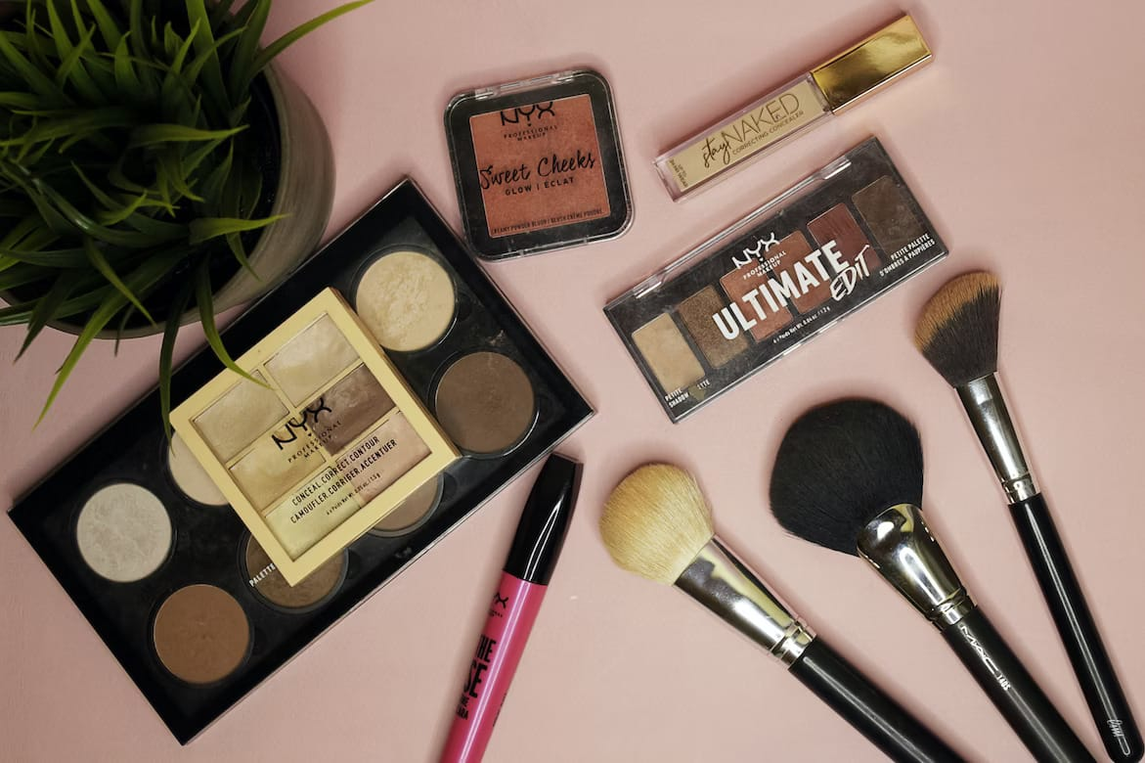
Contents
Smudged proof beauty products
Sales marketing opportunity
Premium is selling
They spent a lot
Cosmetics trading
The mass selling products
Ideas for beauty marketing
Results
Conclusion

Slide 4
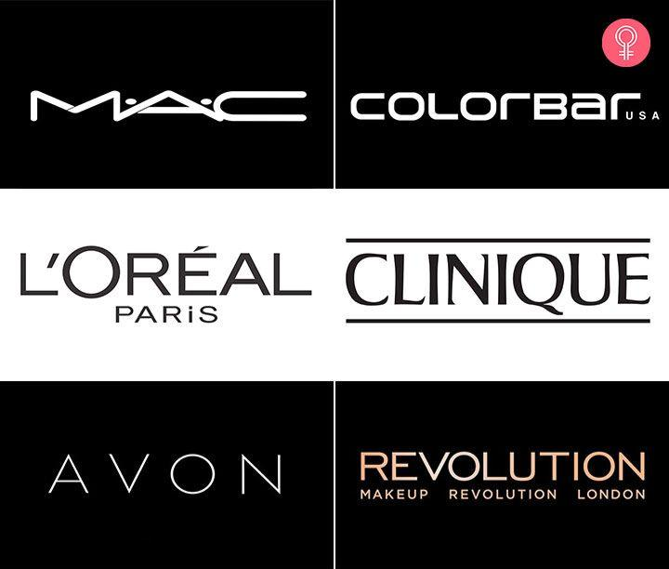
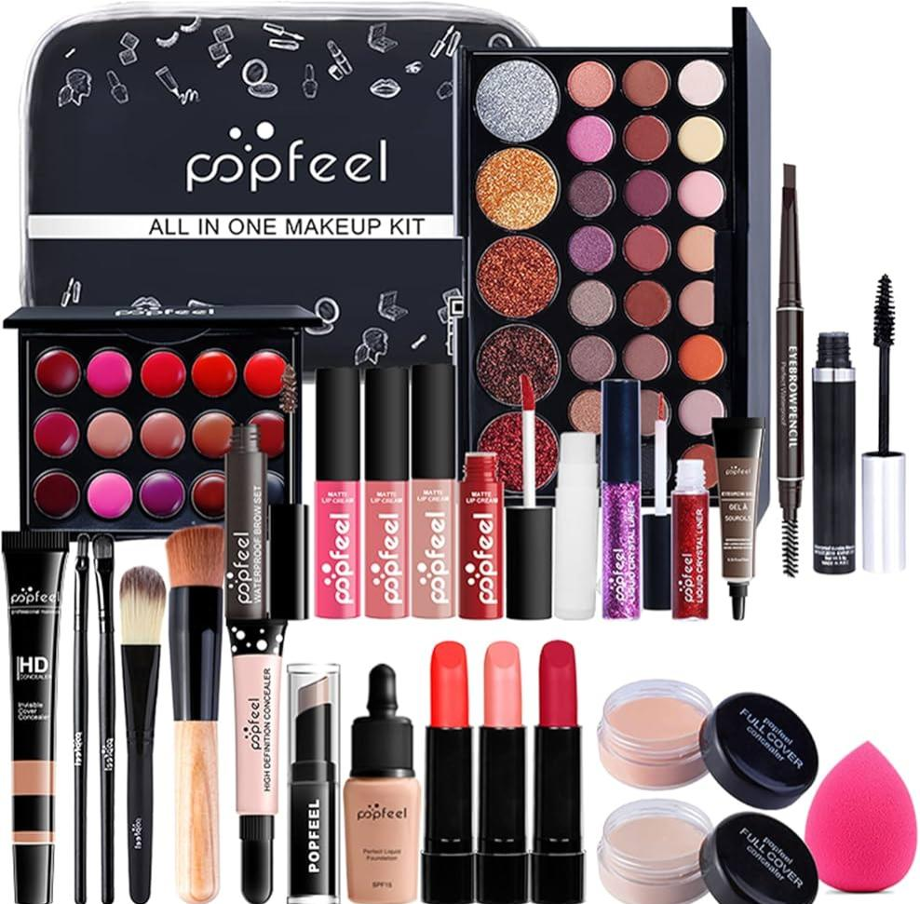
smudged proof beauty products from 50000 to 100000!

Slide 5
Sales marketing opportunity
The study found that between 50% and 60% of kuwaiti women aged between 15 and 55spend considerable amounts of money on beauty,and,given their affluence,seek out the latest products in cosmetics products and services, including skincare, fragrance,nails,spa treatments and plastic surgery.

Slide 6
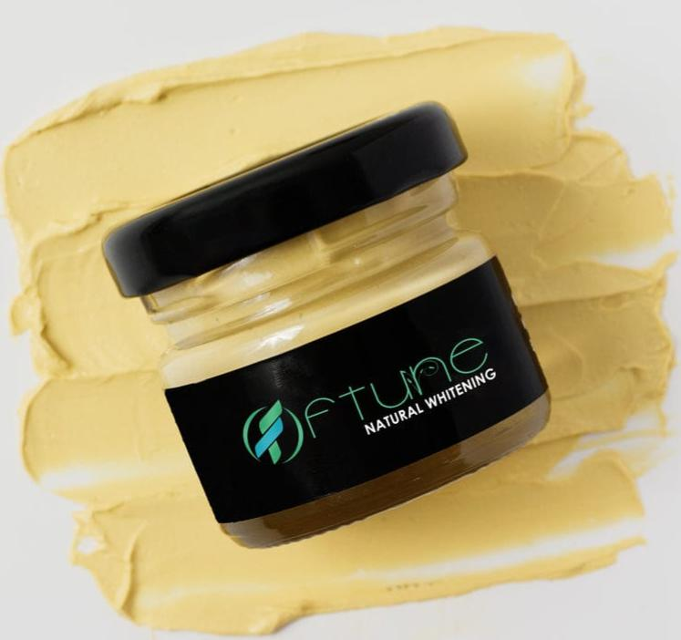
Premium is selling
$1500 gold face cream unveiled in dubai, australia brand lariese revealed the cream at the Mideast natural and organic products expo (menope) in dubai
Bulgarian company Victoria beauty told khaleej times newspaper that genuine Bulgarian oil costs $8000-$10000 per kilo.
Launch of $650 24-carat gold face cream,orlane has revealed a 24-carat gold anti-aging cream,crème royale, costing an eye-watering aed 2387($650)

Slide 7

They spent a lot
Consumers in the United Arab Emirates
(Uae) Meanwhile,have the highest per
Capita outlay on cosmetic and beauty
Products in the region-spending us$156
Each on fragrance alone while total
Sales are expected to top us$30bn by
2024-up us$24bn.

Slide 8
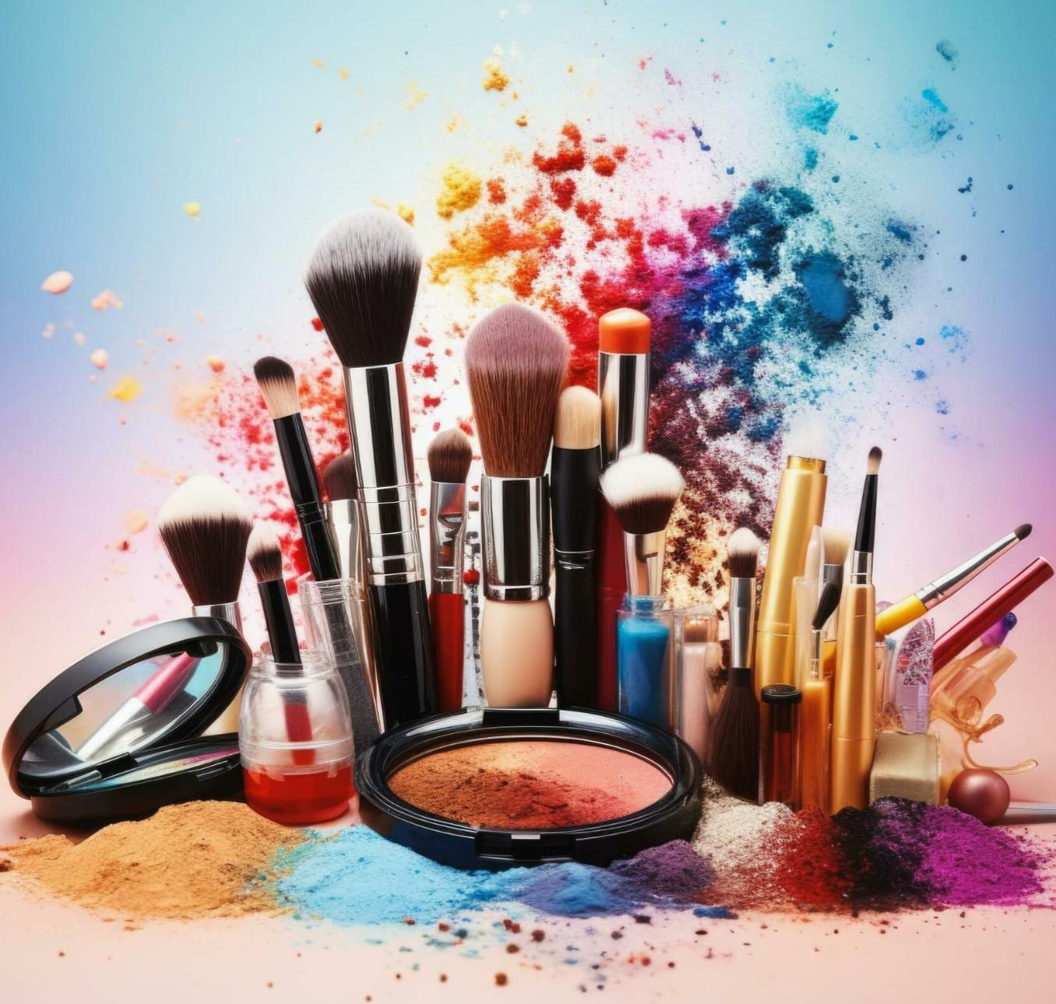
Cosmetic trading
.this all about branding ,reach and presence
.premium multiple brands
.presence across the segment
. Presence across the platform

Slide 9
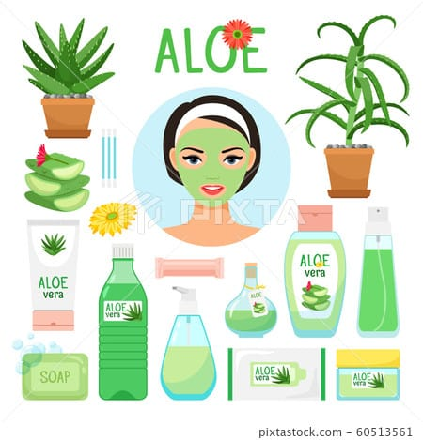
The mass selling products
Natural cosmetics which has mass
Appeal across the segments
Aloe vera
Face mask
Skin care
Natural white soil
Henna

Slide 10
Ideas for beauty marketing
One of the challenges for beauty marketers is continuously comingup with fresh,new ideas for beauty products.
Publics visually appealing an “InstagramMable content. If you don’t have a huge budget,consider collaborating with talented amateur photographers.
Collaborate with spiring beauty muas( makeup artists)-they love natural cosmetics and many share they skin care routine and tips online, so it’s a powerful way to attract new prospects.
Analyze popular hashtags in a Beauty niche using iq hashtags.then you can easily plan,manage, and schedule your social media post and content.
Offer a free giveaway and try to keep it as creative as possible. The winning entries can receive a price or voucher.

Slide 11
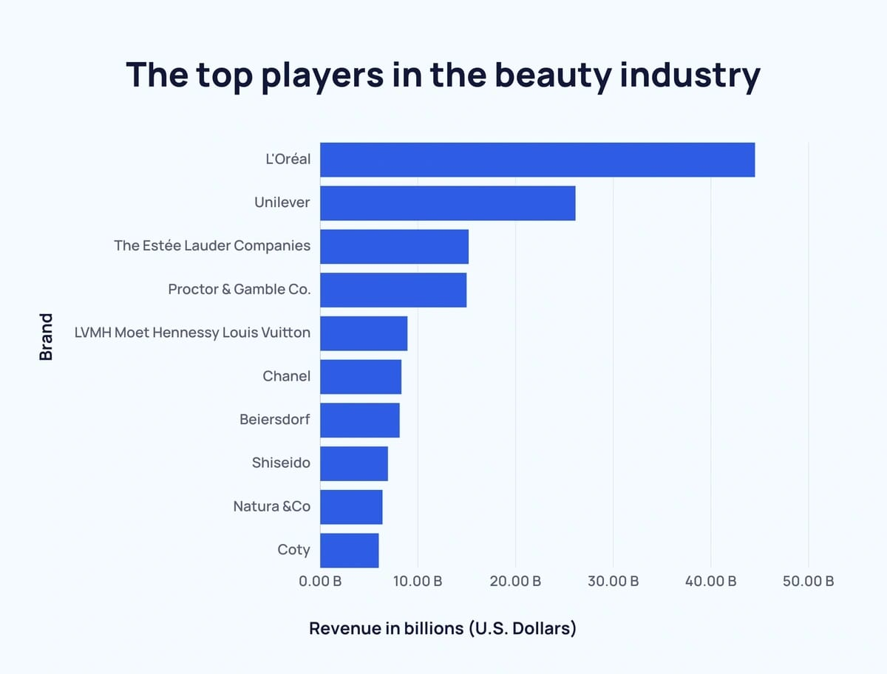
Results
After taking a performance in 2024.beauty Brands are finding
New andinnovative ways to connect with their customers.
Beauty influencers and DTC brands are both influencing and
Adapting to buyer preferences.
Overall the future looks bright fir the beauty for industry.
The beauty industry generates over $100 billion in
Revenue in world wide .
The men’s personal care market is projected to hit $276.9
BillIon by 2030.
Skin care is projected to generate upto$177billion bu 2025.
L’Oreal is the leading beauty products company with
Over $40 billion in global sales

Slide 12
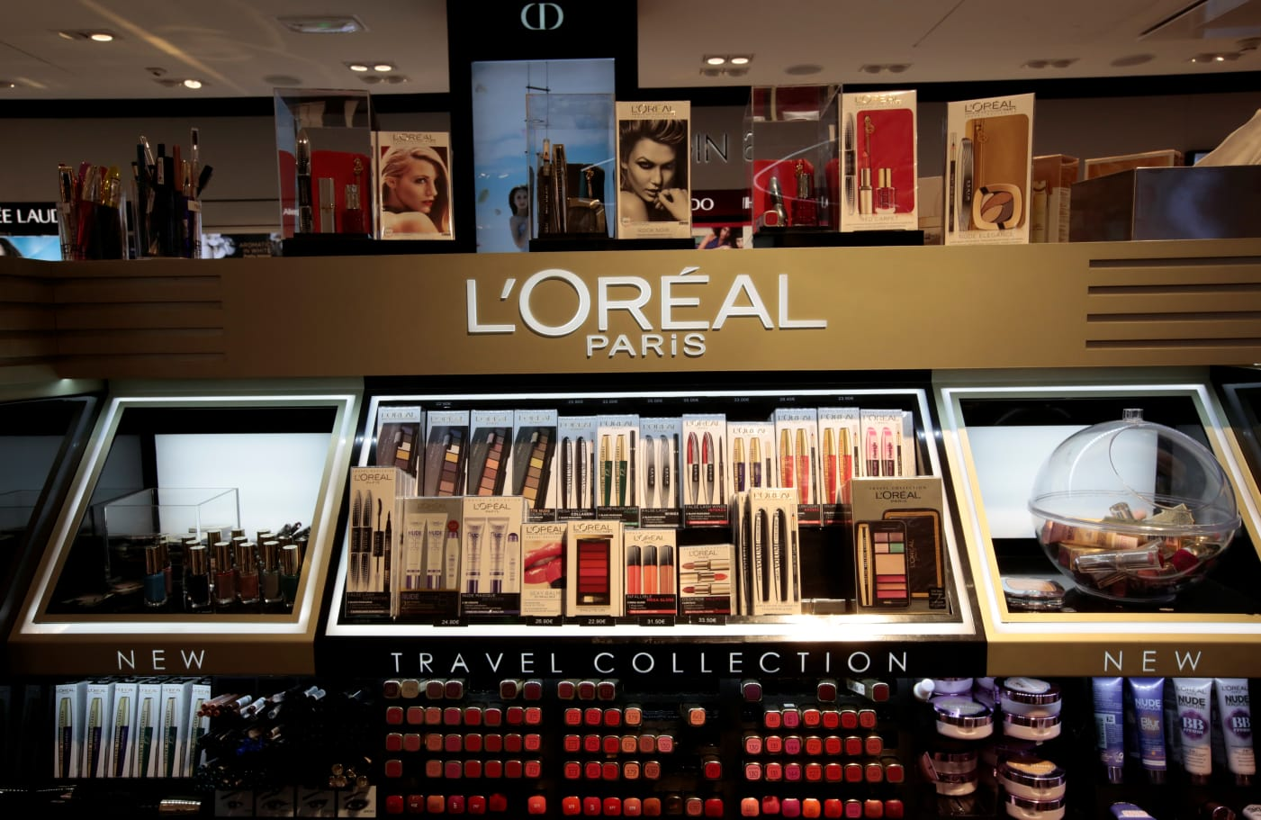
Conclusion
After completing this presentation I came to the
Conclusion that majority of the people prefer
L’oreal to hul skin care products because of its
Quality,brand and the goodwill of the company.

Slide 13
Thank you

